Slide 1
Anatomy of a Git Project
Victor Grazi – VP DevOps Core Services
Nomura Securities
New York, NY
Notes:
If you are from the SVN world, you probably have a local workspace and a remote repository for each project.
Git is much different. There is no difference between the structure of the remote machine and your local clones. (Any local git repo can be a remote as well)
git init creates a local Git repo.
There are three areas in a Git local repo:
Working area
Staging area (or Index)
Repository
There is one HEAD, that points to the branch where your commits and checkouts will occur.
Every local git command either moves data between the areas or moves the current head

Slide 2
Getting to Know Git
SVN projects:
local workspace
and remote repository.
Git remote & local clones look exactly alike.
git init creates a local Git repo.
Three areas in a Git local repo:
Working area
Staging area (or Index)
Repository
Notes:
If you are from the SVN world, you probably have a local workspace and a remote repository for each project.
Git is much different. There is no difference between the structure of the remote machine and your local clones. (Any local git repo can be a remote as well)
git init creates a local Git repo.
There are three areas in a Git local repo:
Working area
Staging area (or Index)
Repository
There is one HEAD, that points to the branch where your commits and checkouts will occur.
Every local git command either moves data between the areas or moves the current head

Slide 3
Getting to Know Git
HEAD points to the branch where your commits and checkouts will occur.
Git commands either:
Move data between these areas. Or
Move the current head. Or
Run a report
Notes:
If you are from the SVN world, you probably have a local workspace and a remote repository for each project.
Git is much different. There is no difference between the structure of the remote machine and your local clones. (Any local git repo can be a remote as well)
git init creates a local Git repo.
There are three areas in a Git local repo:
Working area
Staging area (or Index)
Repository
There is one HEAD, that points to the branch where your commits and checkouts will occur.
Every local git command either moves data between the areas or moves the current head

Slide 4
Git - Initial setup
Install Git client from AMS: Git_Git-Gui-x64_2.15.1_EN_01
Generate SSH keys: https://gitlab.nomura.com/help/ssh/README
To create a new project in GitLab, create a Service Now ticket http://intranet.nomuranow.com/RFB/RFBController?action=viewRFBForm&FORM_ID=RF000008634
For more information, see DevOps Git Tactical Playbook: http://gm-dev-tools.nomura.com/ETCB/confluence/display/DEVOPS/Playbook+-+GitLab
Optimizations for Git Bash slowness: https://blog.praveen.science/solution-to-git-bash-is-very-slow-in-windows/
git config --global core.preloadindex true
git config --global core.fscache true
git config --global gc.auto 256

Slide 5
Git – Common Left to Right Workflow
Working area | Staging Area | Repository (local) | Remote (origin)
> git init # create a local repository
<< create or update files >>
> git add . # copy files to staging area
(git rm --cached <file> # opposite of git add)
> git commit – m “message” # commit staging area to repository
(git commit –a is the same as git add followed by git commit)
> git push # push the commit to the remote
-
Legend
Untracked
Uncommitted
Committed
Notes:
Once you do an init, you can start versioning anything under that directory. No need for a remote

Slide 6
Git – Common Left to Right Workflow
Working area | Staging Area | Repository (local) | Remote (origin)
Legend
> git commit – m “message”
# commit staging area to repository
(git commit –a is the same as git add, followed by git commit)
-
Untracked
> git init # create a local repository
<< create or edit your files >>
> git add . # copy files to staging area
(git rm --cached <file> # opposite of git add)
Uncommitted
Committed
> git push # push the commit to the remote
Notes:
Once you do an init, you can start versioning anything under that directory. No need for a remote

Slide 7
Git – clone
Working area | Staging Area | Repository (local) | Remote (origin)
Legend
> git clone
Untracked
-
Uncommitted
# init local repo
# and copy remote to local
Committed
Notes:
Once you do an init, you can start versioning anything under that directory. No need for a remote

Slide 8
Git – checkout
Working area | Staging Area | Repository (local) | Remote (origin)
Legend
Untracked
Legend
Uncommitted
Committed
Untracked
> git checkout <branch>
Uncommitted
-
Committed
# copy branch to working area
(Note checkout will prompt to overwrite local changes)
Notes:
Once you do an init, you can start versioning anything under that directory. No need for a remote

Slide 9
Git – Soft Reset
Working area | Staging Area | Repository (local) | Remote (origin)
> git reset --soft <commit# or branch or HEAD>
-
# moves the HEAD pointer to the specified commit # Does not touch staging # or working areas
Legend
Untracked
Uncommitted
Committed
Notes:
Once you do an init, you can start versioning anything under that directory. No need for a remote

Slide 10
Git – Mixed reset
Working area | Staging Area | Repository (local) | Remote (origin)
> git reset <commit# or branch or HEAD>
# copy commit to staging but not # to working area # (-- mixed is default)
-
Legend
Untracked
Uncommitted
Committed
Notes:
Once you do an init, you can start versioning anything under that directory. No need for a remote

Slide 11
Git – hard reset
Working area | Staging Area | Repository (local) | Remote (origin)
Legend
Untracked
> git reset --hard <commit# or branch or HEAD>
Uncommitted
Committed
-
> # copy the commit to staging and
> # working areas, and moves > # HEAD pointer to that commit
Legend
Untracked
Uncommitted
Committed
Notes:
Once you do an init, you can start versioning anything under that directory. No need for a remote

Slide 12
-
Git – fetch / merge / pull
Working area | Staging Area | Repository (local) | Remote (origin)
> git fetch
# update from remote to local. HEAD ptr unchanged
> git merge
Legend
# merges the commits and
Untracked
# advances the HEAD pointer
Uncommitted
<< git pull == git fetch + git merge >>
Committed

Slide 13
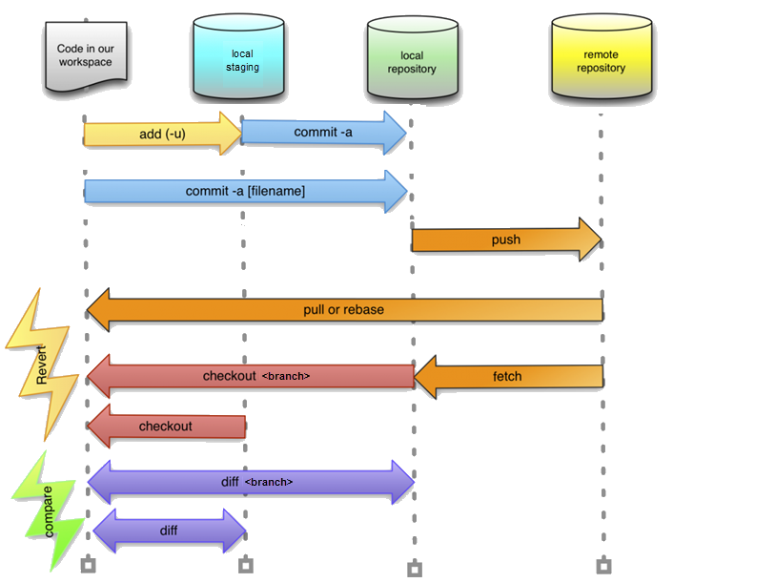
Notes:
git init
git status
git add
(to delete a file from Git, delete it locally, then do git add <file> then git commit
gitk – open git log browser
git commit –m “message”
git branch
git branch <name>
git branch –d <name> // delete branch
HEAD points to a branch, branch points to the commit
branch points to a commit
add git --cached

Slide 14
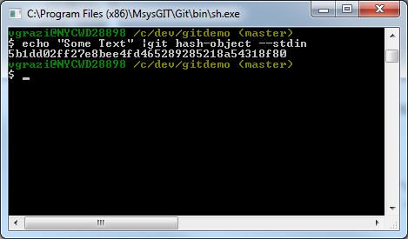
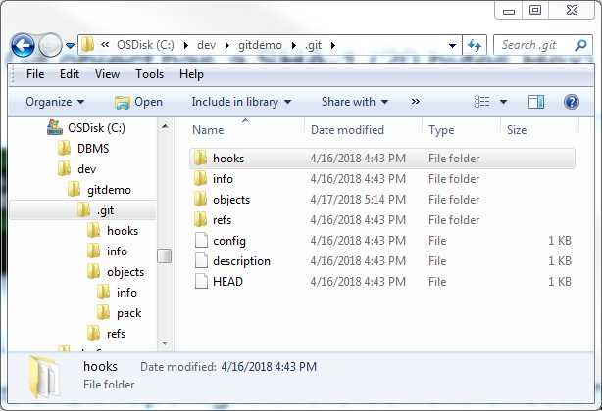
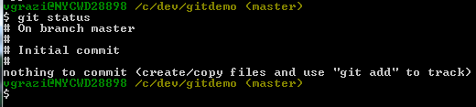
Digging in
Every Git object has a SHA-1 (20 bytes Hex)
echo “Some text” | git hash-object –stdin
git init - creates a Git repo
right in the current directory:
git cat-file -p <sha-1> Displays the object content
git status

Slide 15
Digging in
Every Git object has a SHA-1 (20 bytes Hex)
echo “Some text” | git hash-object –stdin
git init - creates a Git repo
right in the current directory:
git cat-file -p <sha-1> Displays the object content

Slide 16
Digging in
git status

Slide 17
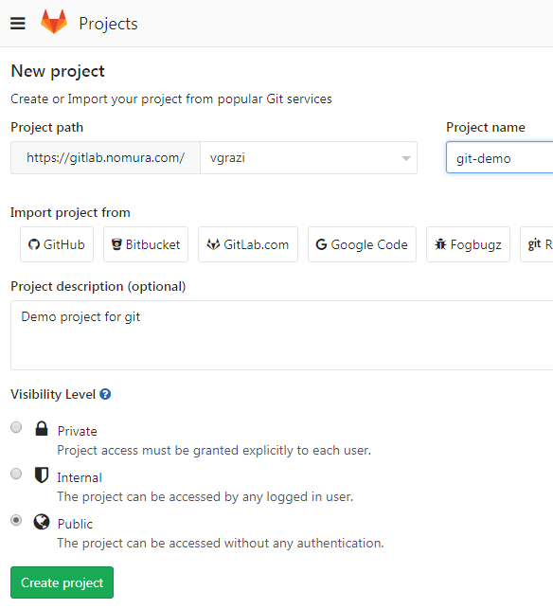

Recommend using Git Bash, installed as part of the Git installation
If you like Unix commands, this provides a highly usable unix Bash shell in Windows
To create a new project in Gitlab:

Slide 18
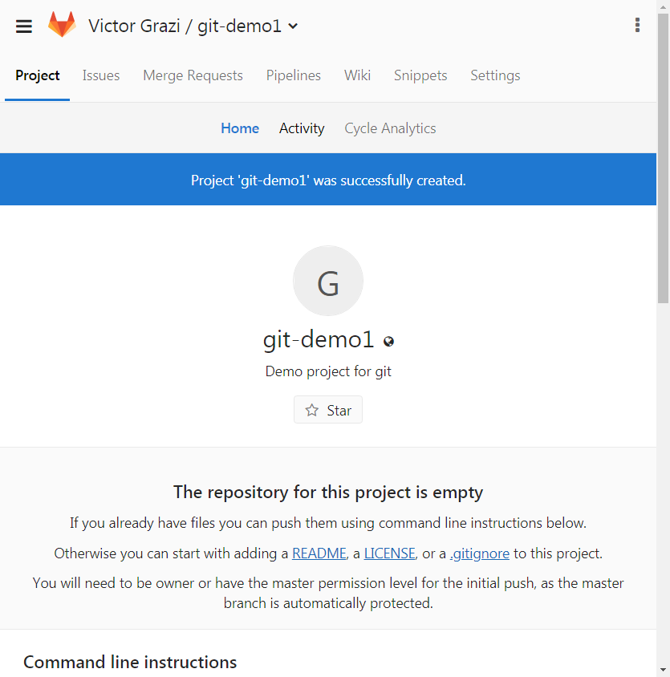
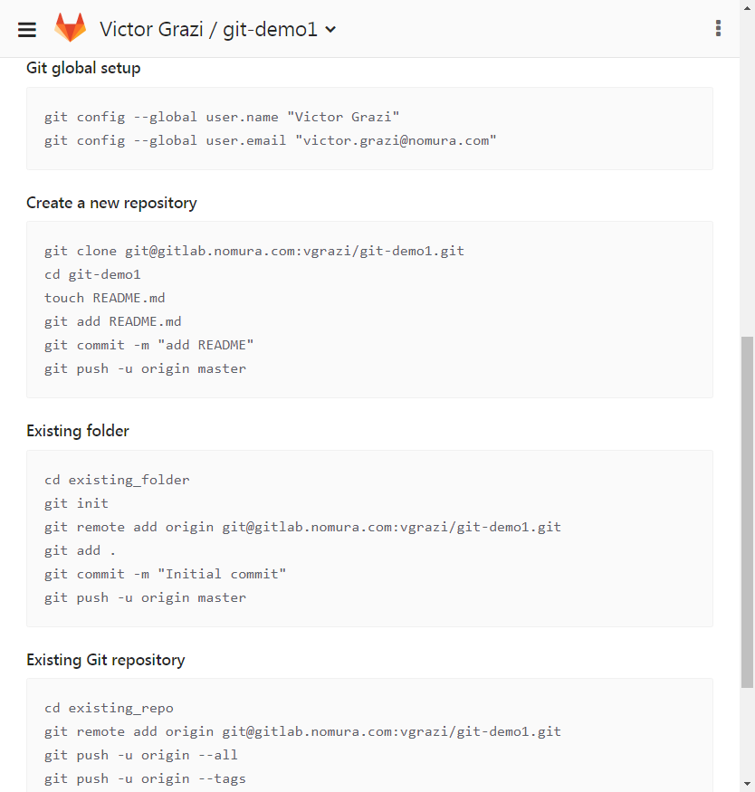

Slide 19
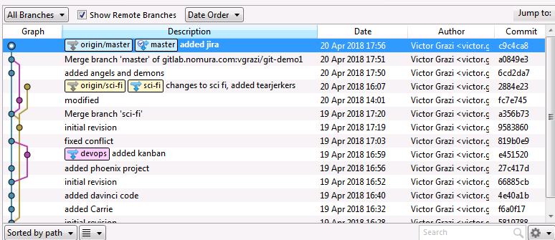
Git –
Notes:
Once you do an init, you can start versioning anything under that directory. No need for a remote

Slide 20
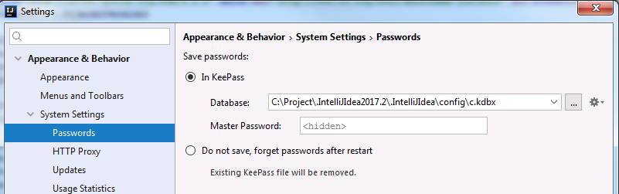

Slide 21

git ignore
IntelliJ
FMI https://www.jetbrains.com/help/idea/using-git-integration.html
Local changes (Alt-9)
In file markers:
Ctrl-A Annotate – click to show files in the commit, click to show diffs
Ctrl-Shift-Alt Down/Up arrow to navigate to next/previous change
View/ Restore changed lines
Ctrl-K Stage area
Ctrl-T
log
cherry pick
stash/
squash
reset
revert

Slide 22
More information
Git documentation: https://git-scm.com/doc

